Slide 1
Time management

Slide 2
WHAT IS TIME MANAGEMENT ??
Time management is the process of organizing and planning how to divide your time between different activities. Get it right, and you'll end up working smarter, not harder, to get more done in less time – even when time is tight and pressures are high.

Slide 3
IMPORTANCE OF TIME MANAGEMENT
Time management is an extremely important parameter in utilizing the existing time and ensuring maximum work is done in that period. Every individual, whether a student, professional, manager, entrepreneur or home-maker have limited time available in which multiple tasks have to be completed. Without time management, one would never be able to complete tasks in a given time period.
It would also hamper the quality of output, efficiency and increase work load. Hence, time management is important in ensuring completing tasks based on priority in a limited time period. Apart from time management, the other effective skills for management are leadership, team management, good governance, decision making, effective communication etc.

Slide 4
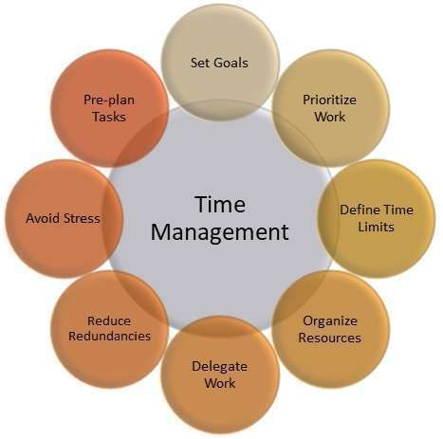
TIPS FOR EFFECTIVE TIME MANAGEMENT
1. Set Goals
For any individual, it is important to set the final objective or goals which need to be achieved. This is the first step in effective time management.
2. Prioritize Work
Certain tasks are more important as compared to others. Hence time management involves prioritizing work and goals so that accordingly time and resources can be allocated.
3. Define Time Limits
Every task needs to be given a certain time period to be completed. Thus, defining a certain time period is required in the management of tasks to be done to achieve goals.
4. Organize Resources
Time management requires that resources which are needed to execute a task are arranged and organized. If that is not done, then there are delays and which eventually leads to incomplete tasks.
5. Delegate Work
Time management also observes that a single individual cannot perform all the tasks single-handedly. Hence delegation of work needs to be done so that workload is divided into smaller goals & tasks, and together it helps to achieve the final goals.
6. Reduce Redundancies
Based on priority, there are certain tasks which can be avoided or certain processes which are redundant. It is utmost important that the non-priority tasks and irrelevant processes are reduced.
7. Avoid Stress
Time management should be done in such a way that it creates a stress-free working environment. Based on planning and prioritizing, stressful work situations must be avoided, as stress will lead to poor efficiency and work output.

Slide 5
ADVANTAGES OF TIME MANAGEMENT
1. Time management helps in increasing efficiency and motivation of people.
2. Optimal utilization of resources are done by better planning & team management.
3. Leadership skills are honed by better and efficient time management.
4. Wastage and redundant processes are reduced.
5. Time management helps in cost reduction as prioritized tasks are given preference.
6. Lesser efforts have to be done as repetitive tasks are avoided.
7. Time management reduces tasks and improved work life balance.
8. Improved efficiency at workplace helps in career development for an employee.

Slide 6
EXAMPLES OF TIME MANAGEMENT
For Students
Time has to be managed keeping in mind the preparation for the final exams. Hence, students have to daily give time for college classes, spend some time in the library, play sports with friends, complete assignments and spend time with family. Allocating the right amount of time would help students be stress free and perform well.
For managers and professionals
Time management is about ensuring achieving daily, weekly, monthly or quarterly goals. Hence people need to plan the to-do lists, priorities tasks based on deliverables & revenue impact, acquire new skills, focus on fitness and give personal time to family. Thus, companies offer things like flextime and the working time for employees. Above that, employees are also compensated with overtime pay.
Home-Makers
Another time management example is for home-makers. Women who manage households need to manage time by ensuring house hold chores are done, grocery is purchased, kids’ homework is done etc.

